Slide 1

The Missing M
Trainer markova.milica@gmail.com
Assistant ristopavlov@gmail.com

Slide 2
Module Contents
ASP.NET MVC
Model
Transfer Data From Controller To View
ViewBag
ViewData
TempData
Model
Model Decoration
Model vs ViewModel
Model Usage
Code academy @ Skopje, 2018-2019

Slide 3
Transfer Data From Controller To View
ASP.NET MVC
ViewBag(dynamic)
ViewData
TempData
Model
Code academy @ Skopje, 2018-2019

Slide 4
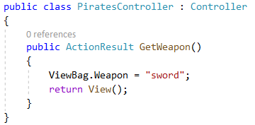

ViewBag
ASP.NET MVC
Allows you to share values dynamically to the view from the controller
A dynamic object without pre-set properties
Code academy @ Skopje, 2018-2019

Slide 5
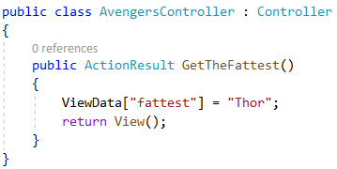
ViewData
ASP.NET MVC
A dictionary object to pass the data from Controller to View where data is passed in the form of key-value pair
Code academy @ Skopje, 2018-2019

Slide 6
TempData
ASP.NET MVC
TempData is a dictionary object to pass the data from one action to other action in the same Controller or different Controllers
Usually, TempData object will be stored in a session object
TempData scope is limited to the next request and if we want Tempdata to be available even further, we should use Keep and peek
Code academy @ Skopje, 2018-2019

Slide 7
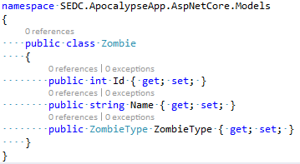
Model
ASP.NET MVC
Is a simple class with properties
Should not contain any server side logic
Code academy @ Skopje, 2018-2019

Slide 8
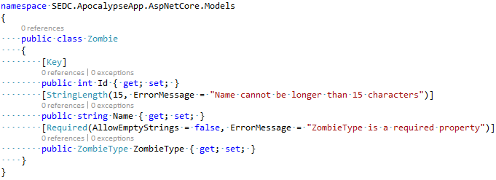
Model Decoration
ASP.NET MVC
Properties can be decorated using attributes
Code academy @ Skopje, 2018-2019

Slide 9
Model vs View Model
ASP.NET MVC
ViewModel is specific for a single View
Model can be reused for multiple views
Model example name: Author
ViewModel example name: AuthorWithBooks
Code academy @ Skopje, 2018-2019

Slide 10
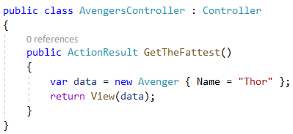

Model Usage
ASP.NET MVC
Code academy @ Skopje, 2018-2019

Slide 11
Demo
ASP.NET MVC
Create an action that uses all of the listed below:
ViewBag
ViewData
TempData
Model
Code academy @ Skopje, 2018-2019

Slide 12
?
ASP.NET MVC
Code academy @ Skopje, 2018-2019

